Slide 1
Encryption and Decryption of data using cryptography algorithm
Submitted by
Diwyanshu
2K19/CO/130

Slide 2
Origins
In 1997, a competition was held by NIST (National Institute for Standards and Technology) to find a new secure encryption method.
Vincent Rijmen and Joan Daeman won the competition with their Rijndael Cipher
In 2001, AES (Advanced Encryption Standard) based on Rijndael cipher became the crypto standard

Slide 3
What is AES?
AES stands for Advanced Encryption Standard. AES Encryption is a method for scrambling data (converting message into encrypted message, means converting into gibberish so no one can understand it). A key is used to mix up data such that it can be securely stored or transferred over a network, and only persons with the key can unscramble the data.

Slide 4
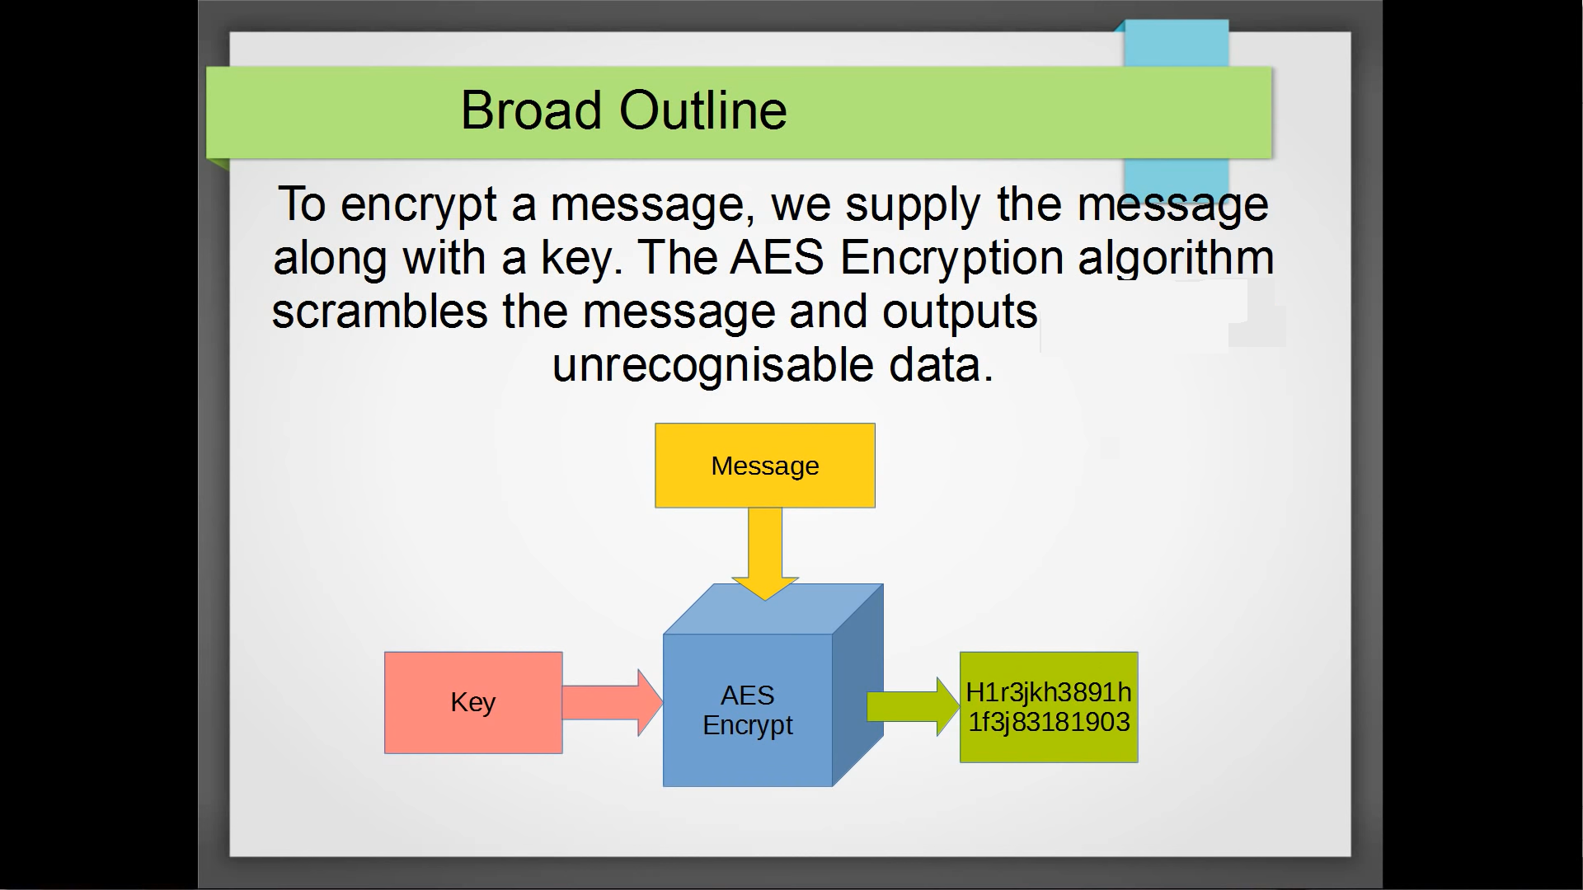
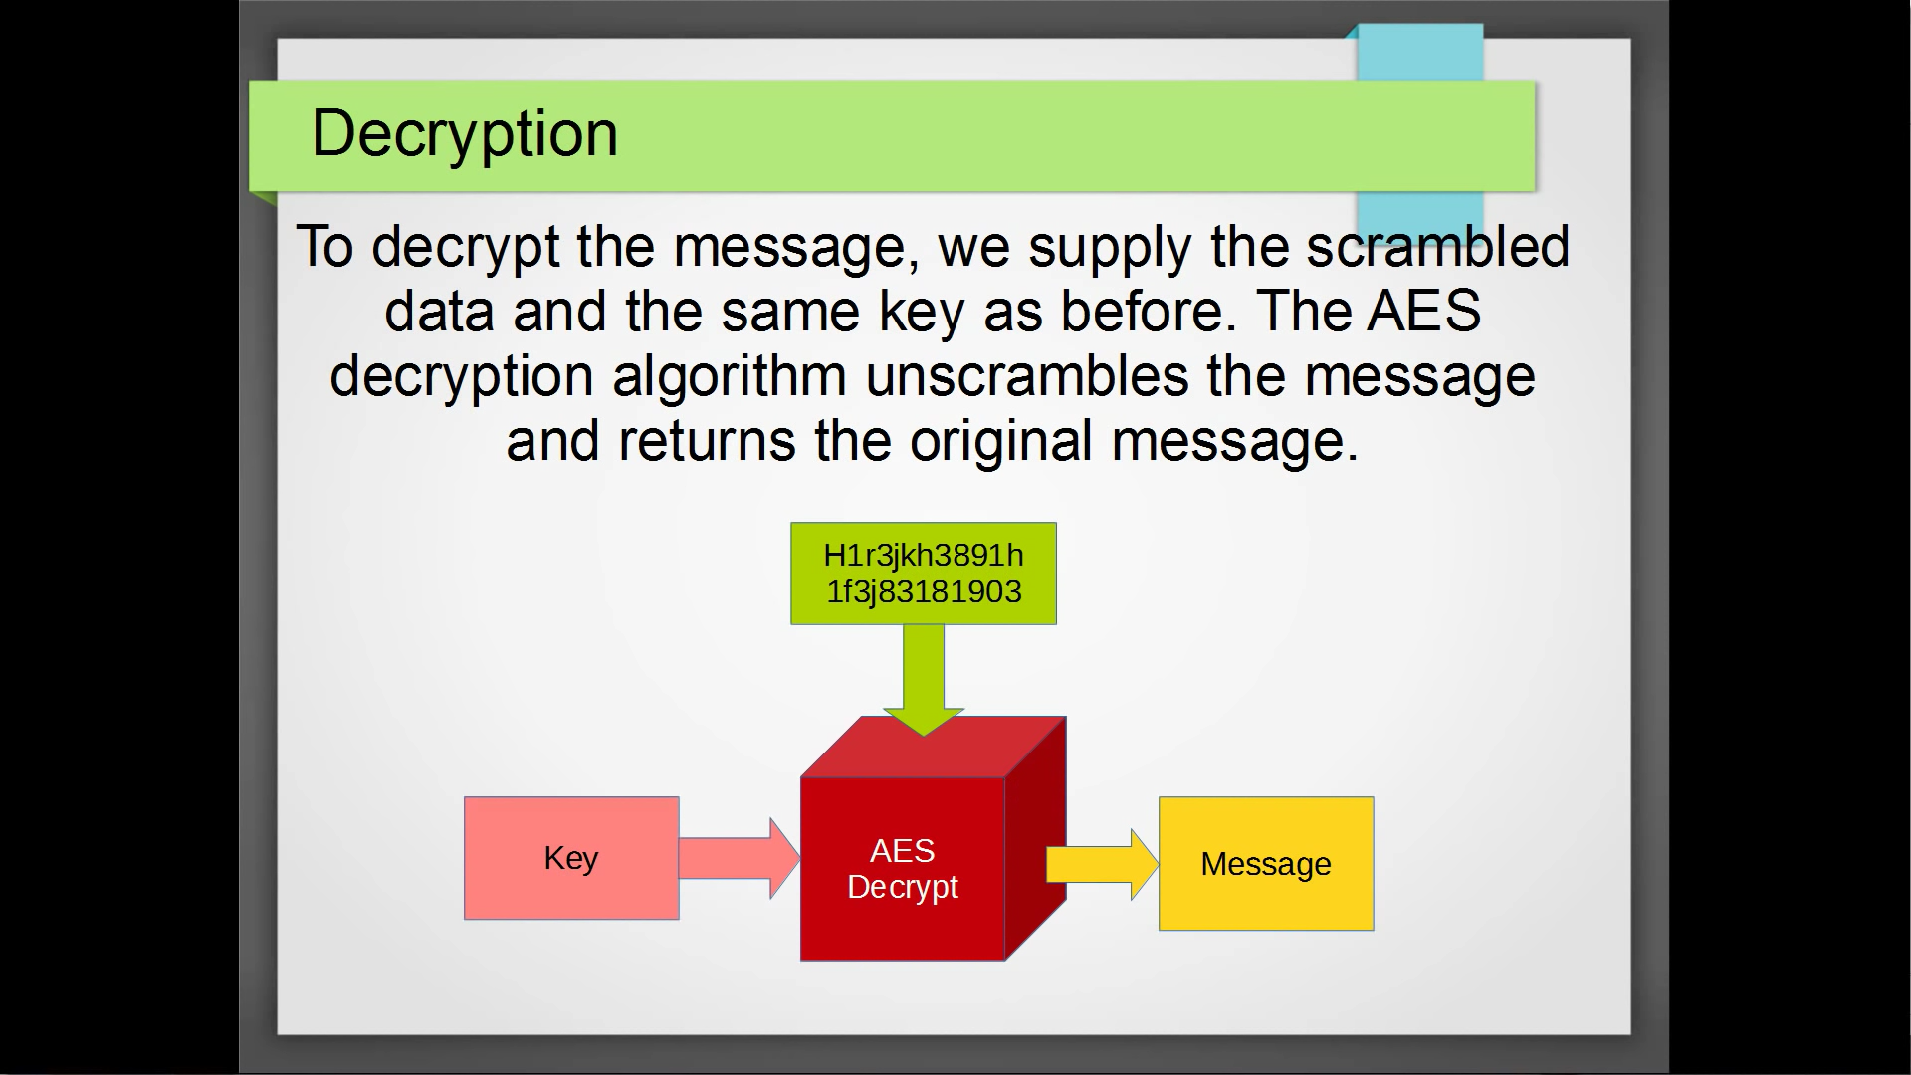
Encryption
Decryption

Slide 5
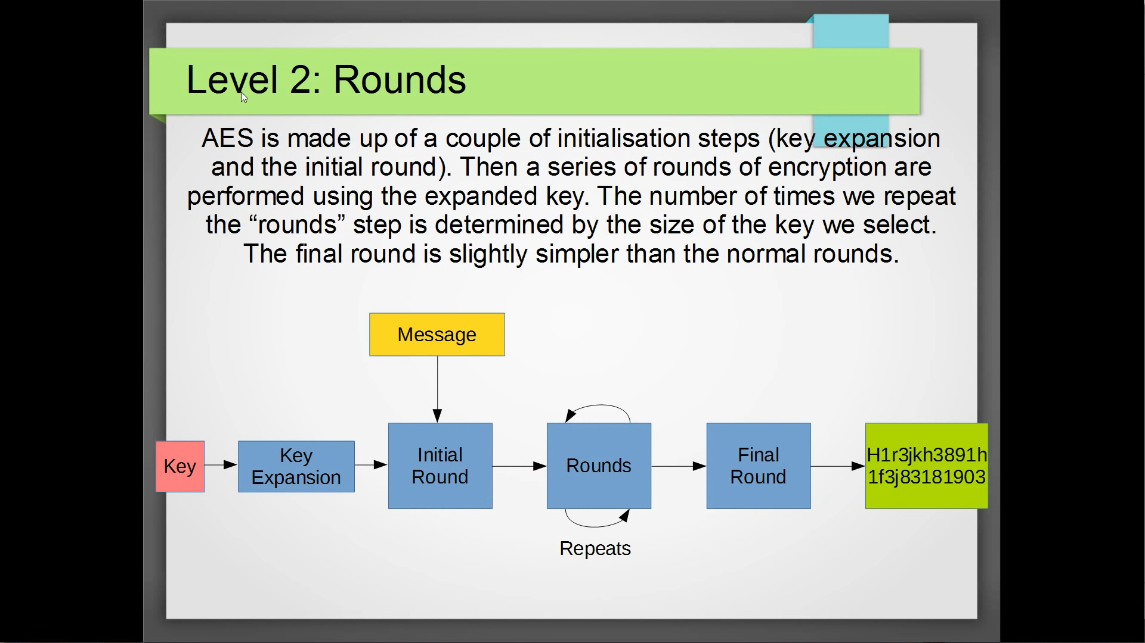
Quick Overview of the Algorithm

Slide 6
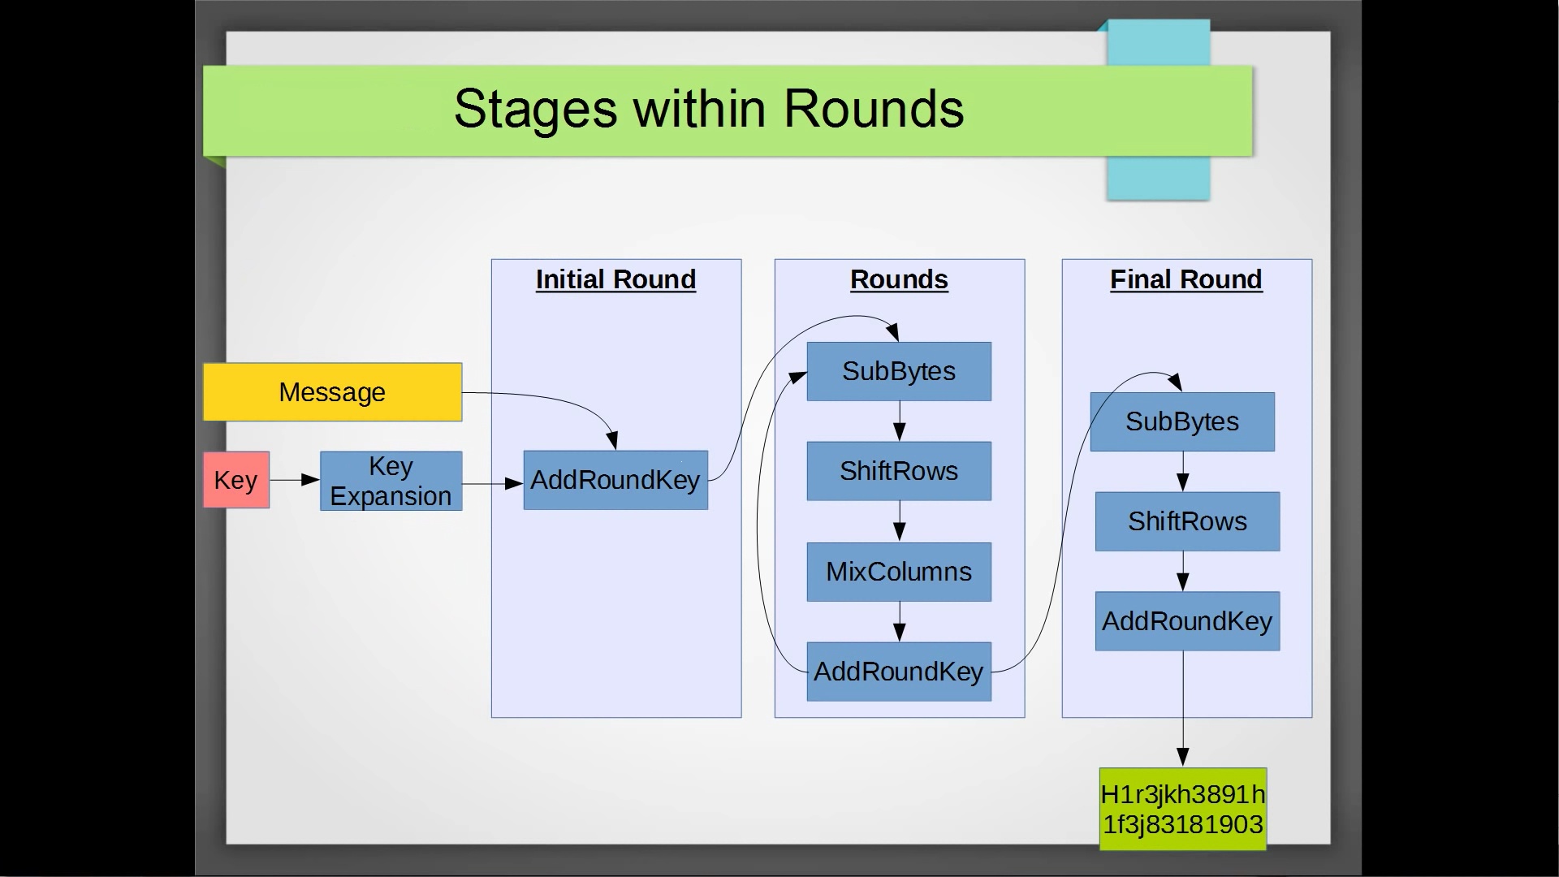

Slide 7
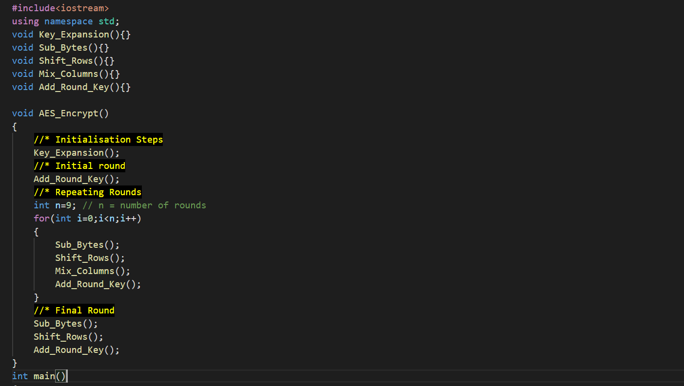
Basic Layout of Algorithm

Slide 8
Description of Algorithm
The algorithm for Advanced Encryption Standard (AES) consists of smaller, sub-algorithms namely SubBytes, ShiftRows, MixColumns, and AddRoundKey. Each method will be explained in details in following slides.

Slide 9
Initialisation
We copy the input message into a new char array called state. We do it in blocks of 16 bytes.
The state/message is best visualised as a 4x4 grid.
Example: if our message is “HELLO WORLD!1234”
H O R 1
E L 2
L W D 3
L O ! 4

Slide 10
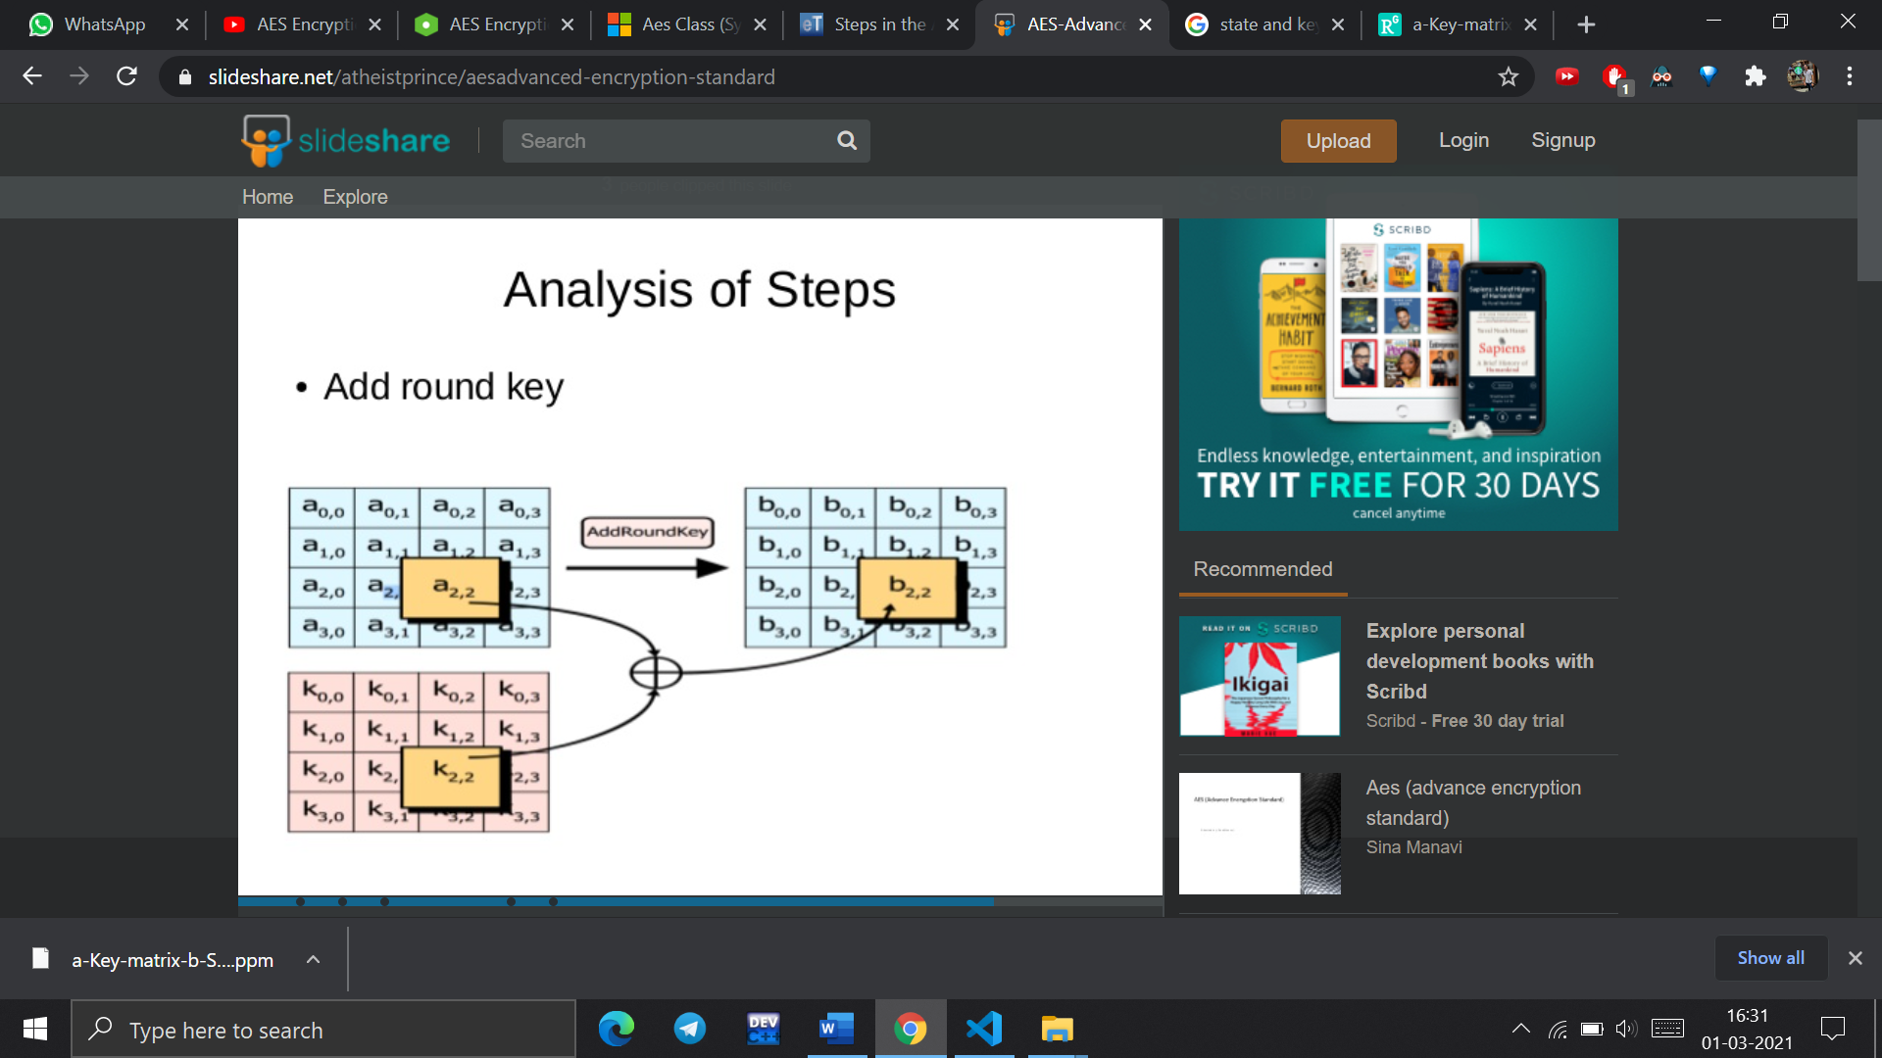
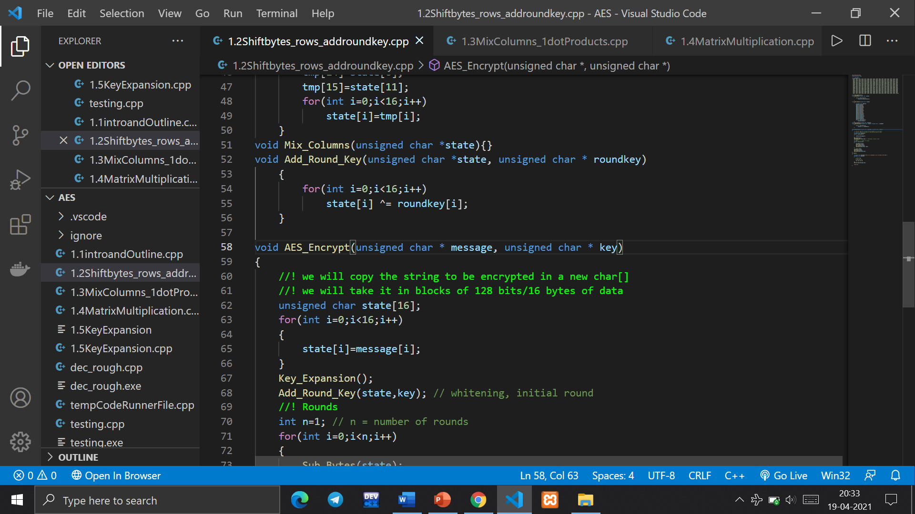
Add Round Key
Every bit in the input is added to the corresponding bit in the round key and the result MOD 2 is stored in state ( this is basically a XOR operation).

Slide 11
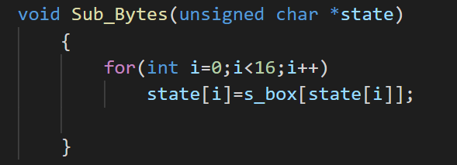
Sub-bytes
In this method each byte/each element in the matrix is replaced using the Rijndael’s S-Box.
This operation is a simple substitution that converts every byte into a different value.
AES defines a table of 256 values for the substitution. You work through the 16 bytes of the state array, use each byte as an index into the 256-byte substitution table, and replace the byte with the value from the substitution table.
Because all possible 256 byte values are present in the table, you end up with a totally new result in the state array, which can be restored to its original contents using an inverse substitution table.
The contents of the substitution table are not arbitrary, the entries are computed using a mathematical formula but most implementations will simply have the substitution table stored in memory as part of the design.

Slide 12
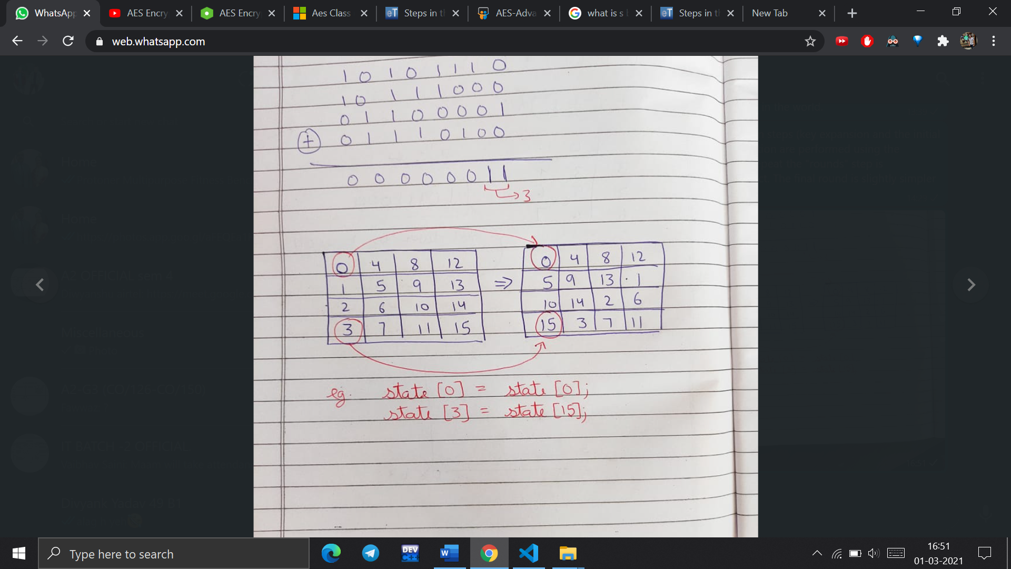
Shift Rows
As the name suggests, Shift Rows operates on each row of the state array. Each row is rotated to the left by a certain number of bytes.
nth row is shifted to the left by n−1 unit
:1st Row: rotated by 0 bytes (i.e., is not changed)
2nd Row: rotated by 1 byte
3rd Row: rotated by 2 bytes
4th Row: rotated by 3 bytes.

Slide 13
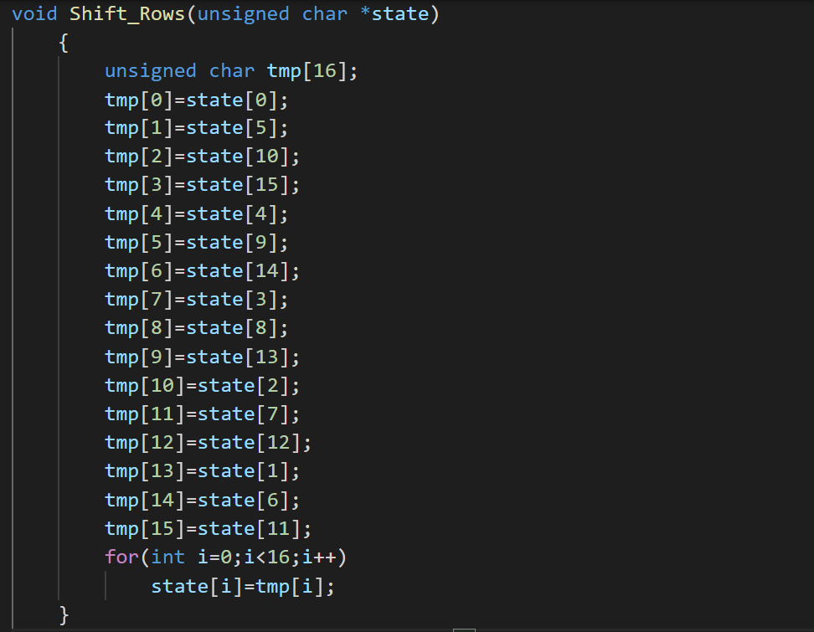
Shift Rows

Slide 14
Mix Columns
We multiply our state with special matrix.
To multiply, we are computing many dot products.
For each dot product, we are multiplying bytes as Galois Fields MOD2
Then we reduce the answers by performing MOD with a special number 100011011

Slide 15
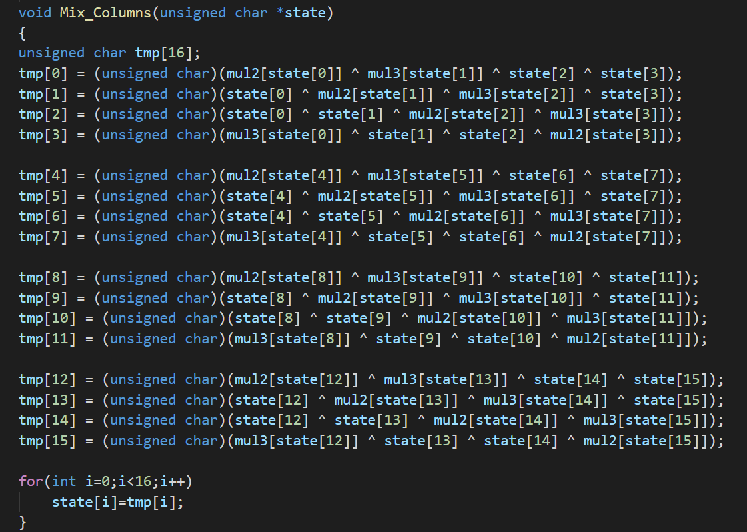
Mix Columns
Detailed explanation in attachment

Slide 16
Key Expansion
We begin with the key supplied to the algorithm and we perform operations to generate new keys, one for each round.
In AES 128 there are an additional 10 rounds, so we need 10 new keys.
The key expansion takes a 128 bit (16byte) key and expands it such that we have a new key for each round.
Each of these keys is 16 bytes wide, and Key including the first round (which uses the supplied key unchanged), we need a total of 176 bytes, 16 bytes for the each of the 10 rounds, and an additional 16 bytes for the original key.

Slide 17
Key Expansion Core
The core of the algorithm is a set of 3 steps.
The core takes a block of 4 bytes from the keys generated so far and performs the following operations:
1.Rotate: This operation treats the 4 bytes as a single unit. We rotate the bytes left by 1 byte.
2. S-Box: In the S-Box step, we swap each byte with the corresponding value from the Rijndael S-Box
3. Rcon: For the Rcon step, we raise 2 to the power of i-1, where is the iteration number. We then add this to the value of the first byte.

Slide 18
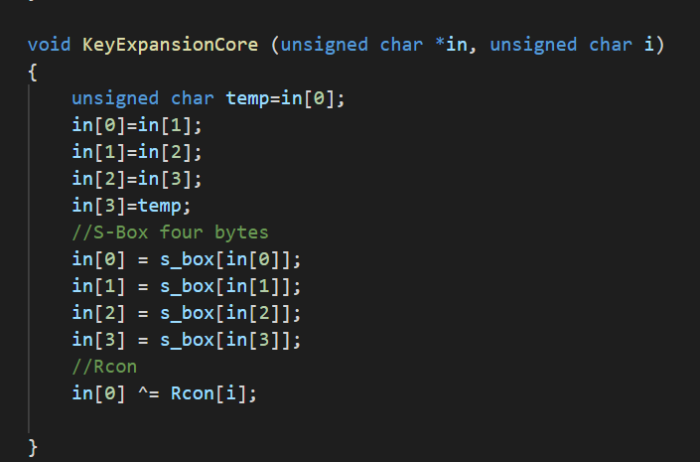
Key Expansion Core

Slide 19
Key Expansion
The first 16 bytes are the original key.
Variables: We need to keep track of how many bytes we've generated, the Rcon iteration value, and we need a temporary variable for when we call the core.
Main Loop:
Read 4 bytes from the core
Perform key expansion core for each 16 byte key
XOR temp with [bytesgenerated-16] and store in expanded keys

Slide 20
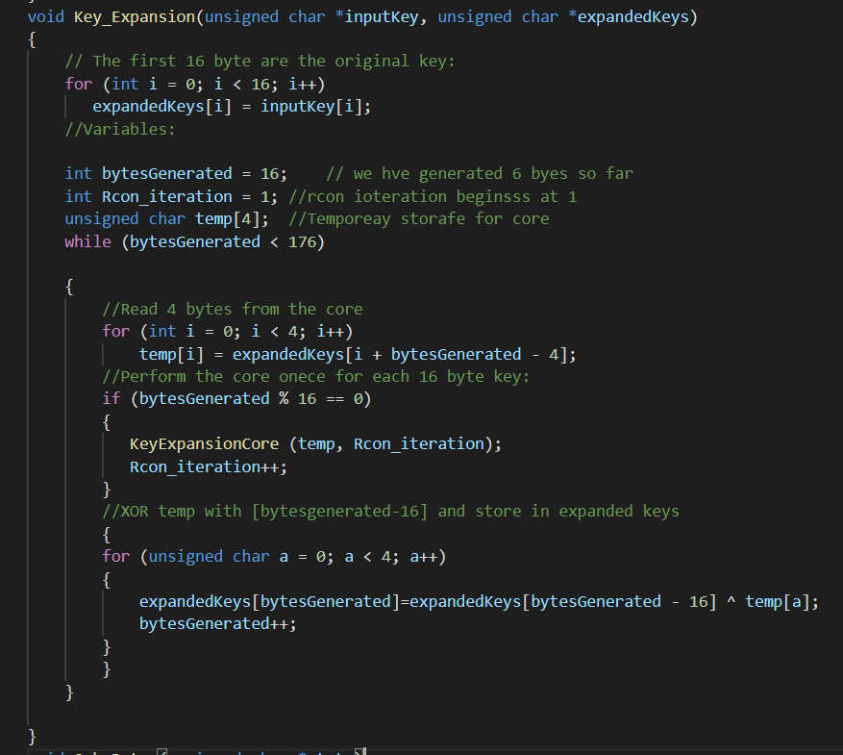
Key Expansion

Slide 21
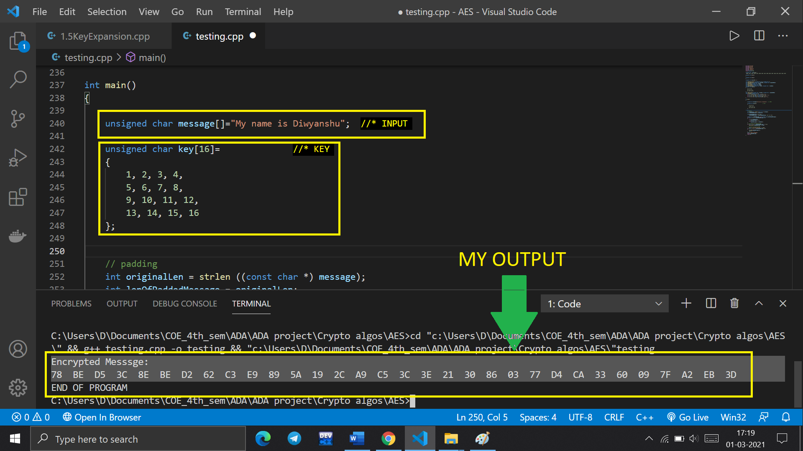
Implementing the encryption

Slide 22
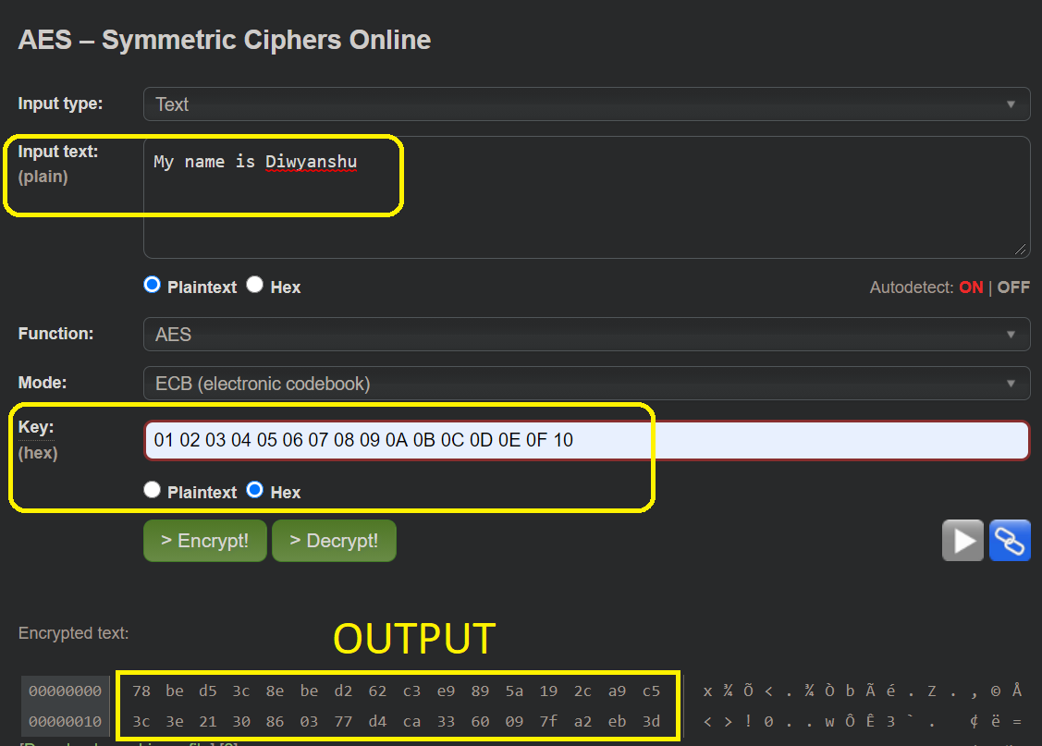
Verifying the result
Using the same input and key on an online AES Tool

Slide 23
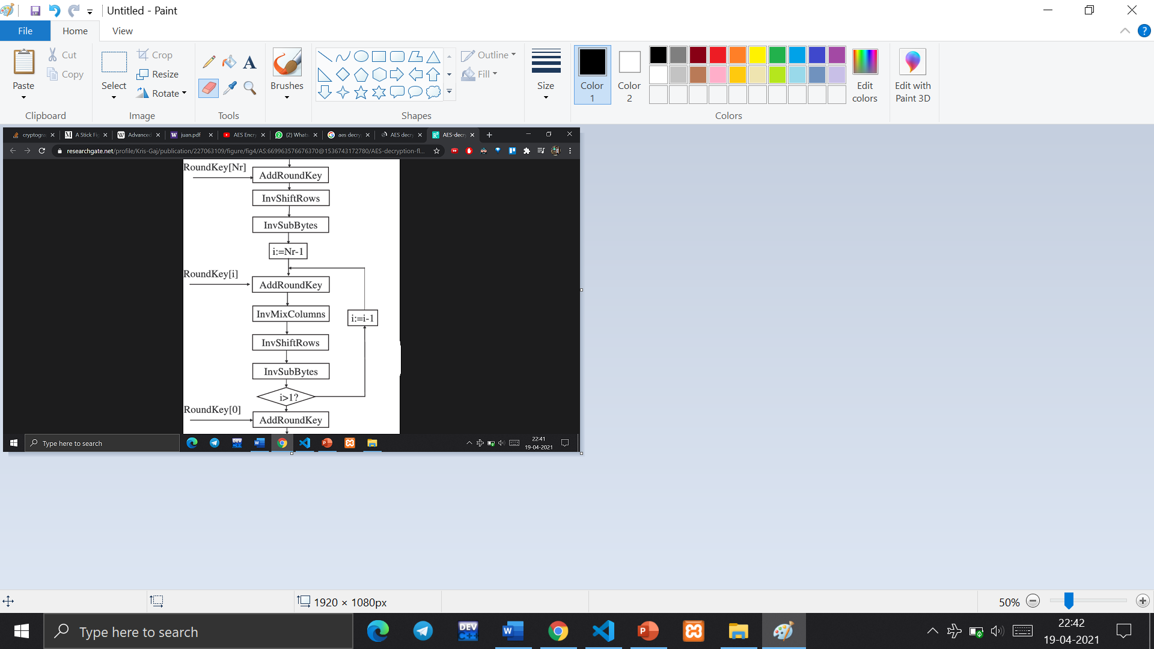
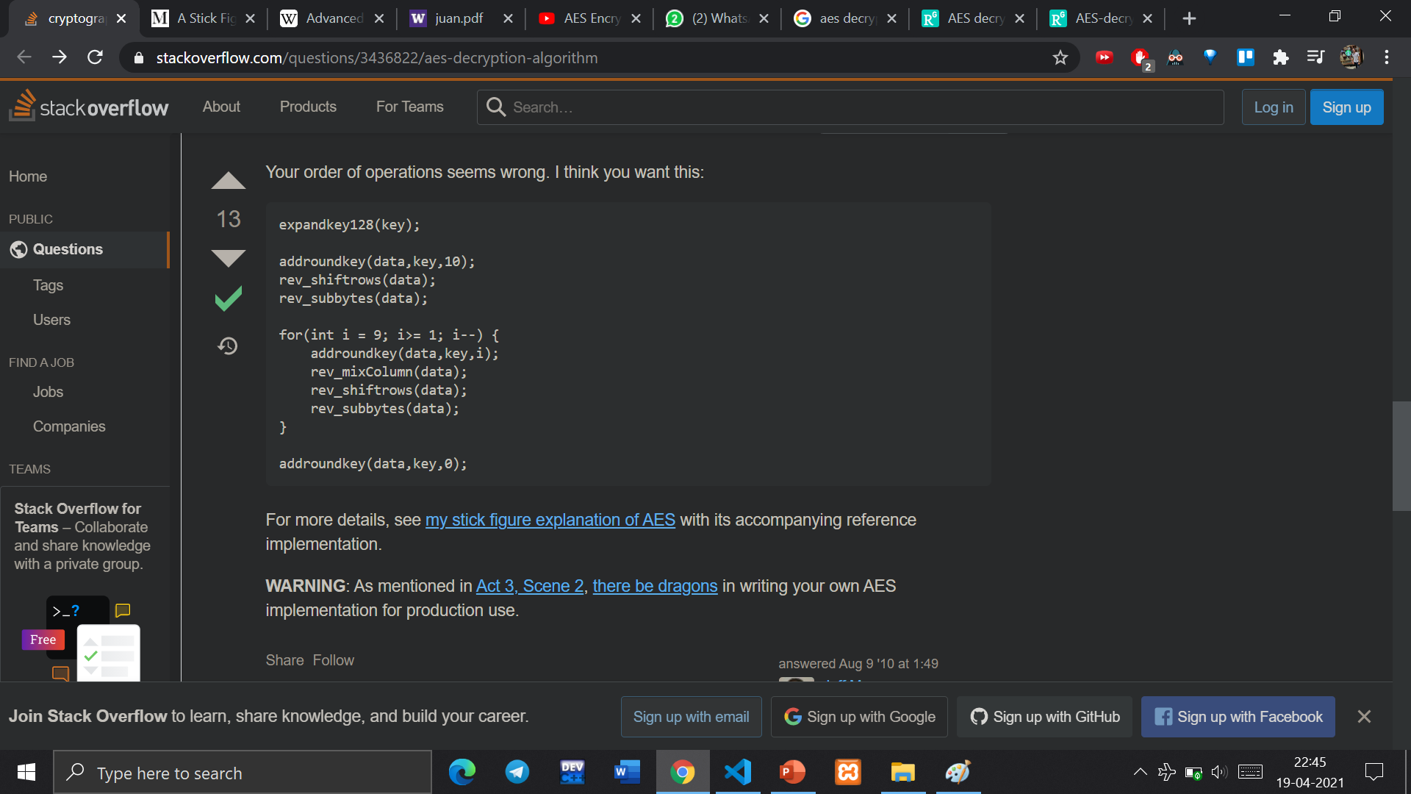
Decryption
A set of reverse rounds are applied to transform ciphertext back into the original plaintext using the same encryption key

Slide 24
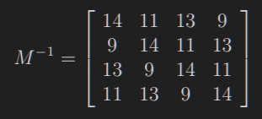
Decryption
Add Round Key: Add Round Key is simply an XOR of state with key. So basically does the same as Add Round Key in the encryption
Reverse Shift Rows: Shifts rows to right instead of left for decryption.
Reverse Sub Bytes: Uses inverse S-box as lookup table
Reverse Mix Columns: The matrix used to revert the state back to its original standing is given by
Reverse Mix Columns uses mul9, mul11, mul13, mul14 look-up tables

Slide 25
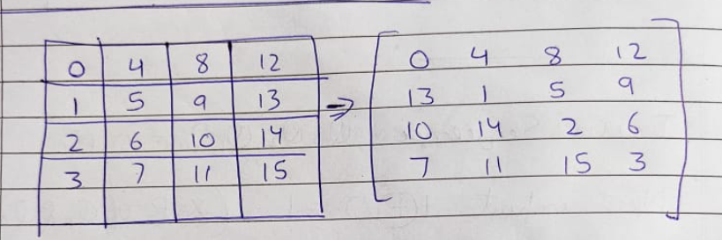
Reverse Shift Rows

Slide 26
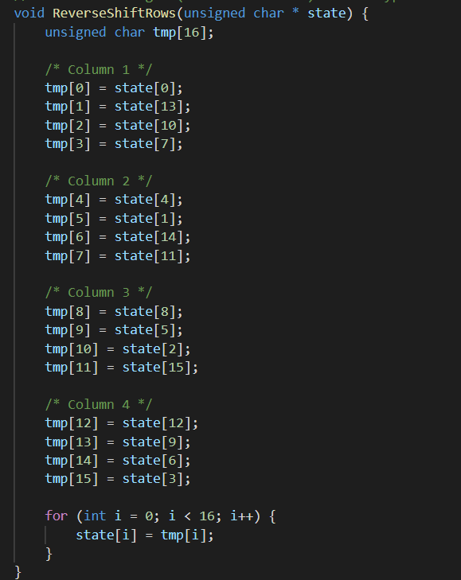
Reverse Shift Rows

Slide 27
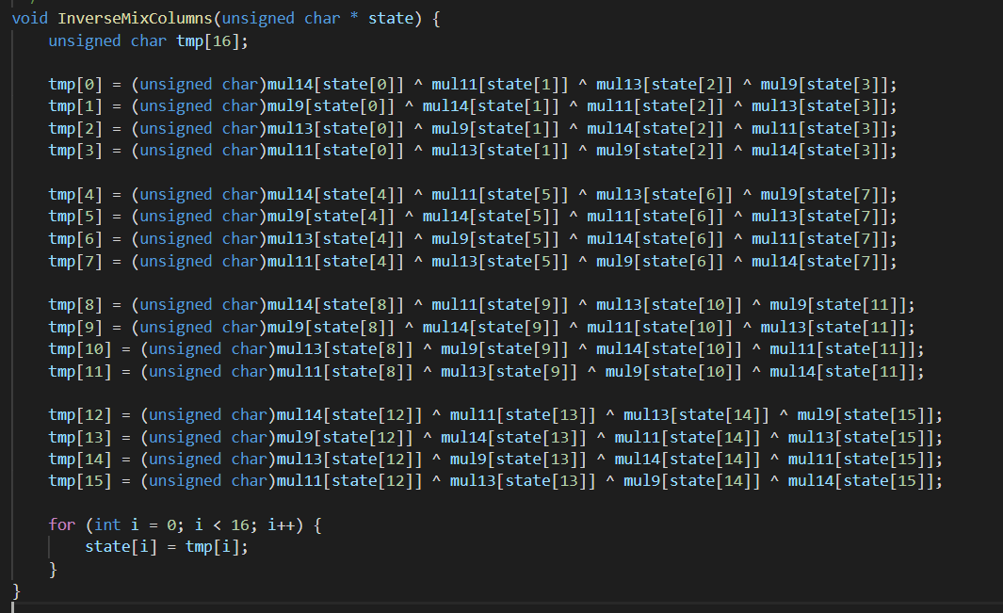
Reverse Mix Column

Slide 28
References
https://en.wikipedia.org/wiki/Advanced_Encryption_Standard#High-level_description_of_the_algorithm
http://www.moserware.com/2009/09/stick-figure-guide-to-advanced.html
https://sites.math.washington.edu/~morrow/336_12/papers/juan.pdf
https://en.wikipedia.org/wiki/Rijndael_MixColumns
https://www.youtube.com/watch?v=4pmR49izUL0&ab_channel=Creel
https://stackoverflow.com/questions/3436822/aes-decryption-algorithm
http://aes.online-domain-tools.com/
https://en.wikipedia.org/wiki/S-box
https://en.wikipedia.org/wiki/AES_key_schedule

Slide 29
THE END

